Slide 1
Brick Project
Replacement of commemorative bricks, filling of insets by
Gazebo, & neatening of Veterans Memorial bricks. Project shepherded by Main Street Volunteer Steve Brooke. Main Street Board accepted bid from brick mason Daniel Tapley who did the work.

Slide 2
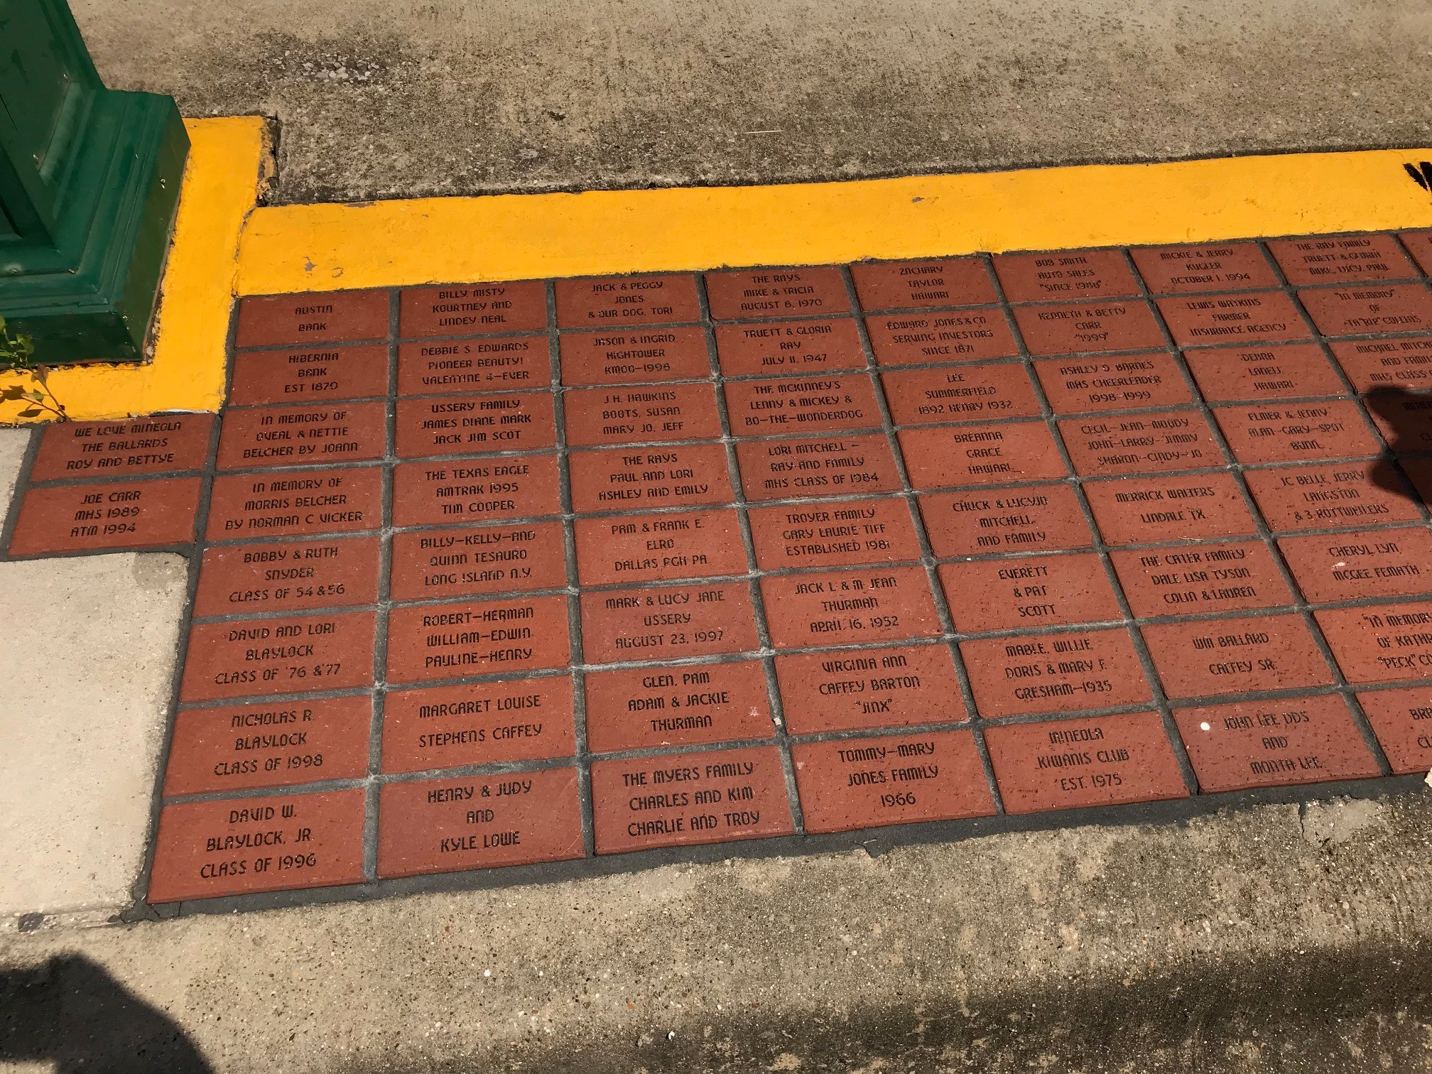
Southeast corner in front of Cheryl’s
BEFORE installation of four replacement commemorative bricks lost in former highway project.

Slide 3
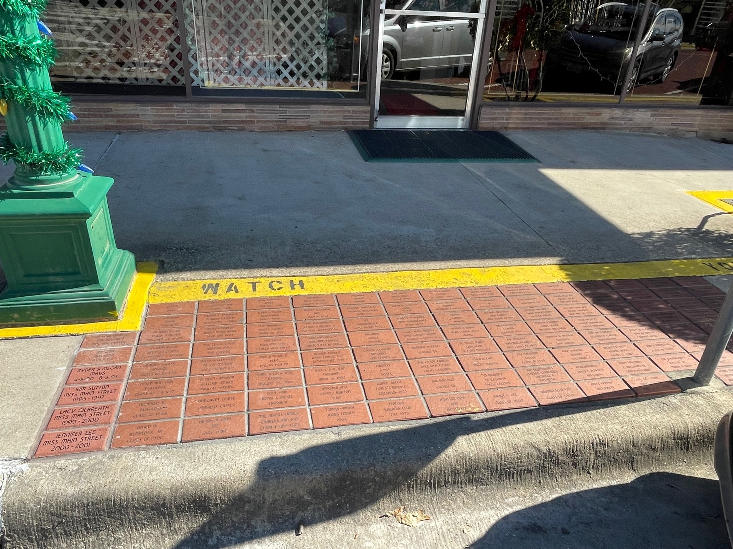
Southeast corner in front Cheryl’s
AFTER replacement of four commemorative bricks.

Slide 4
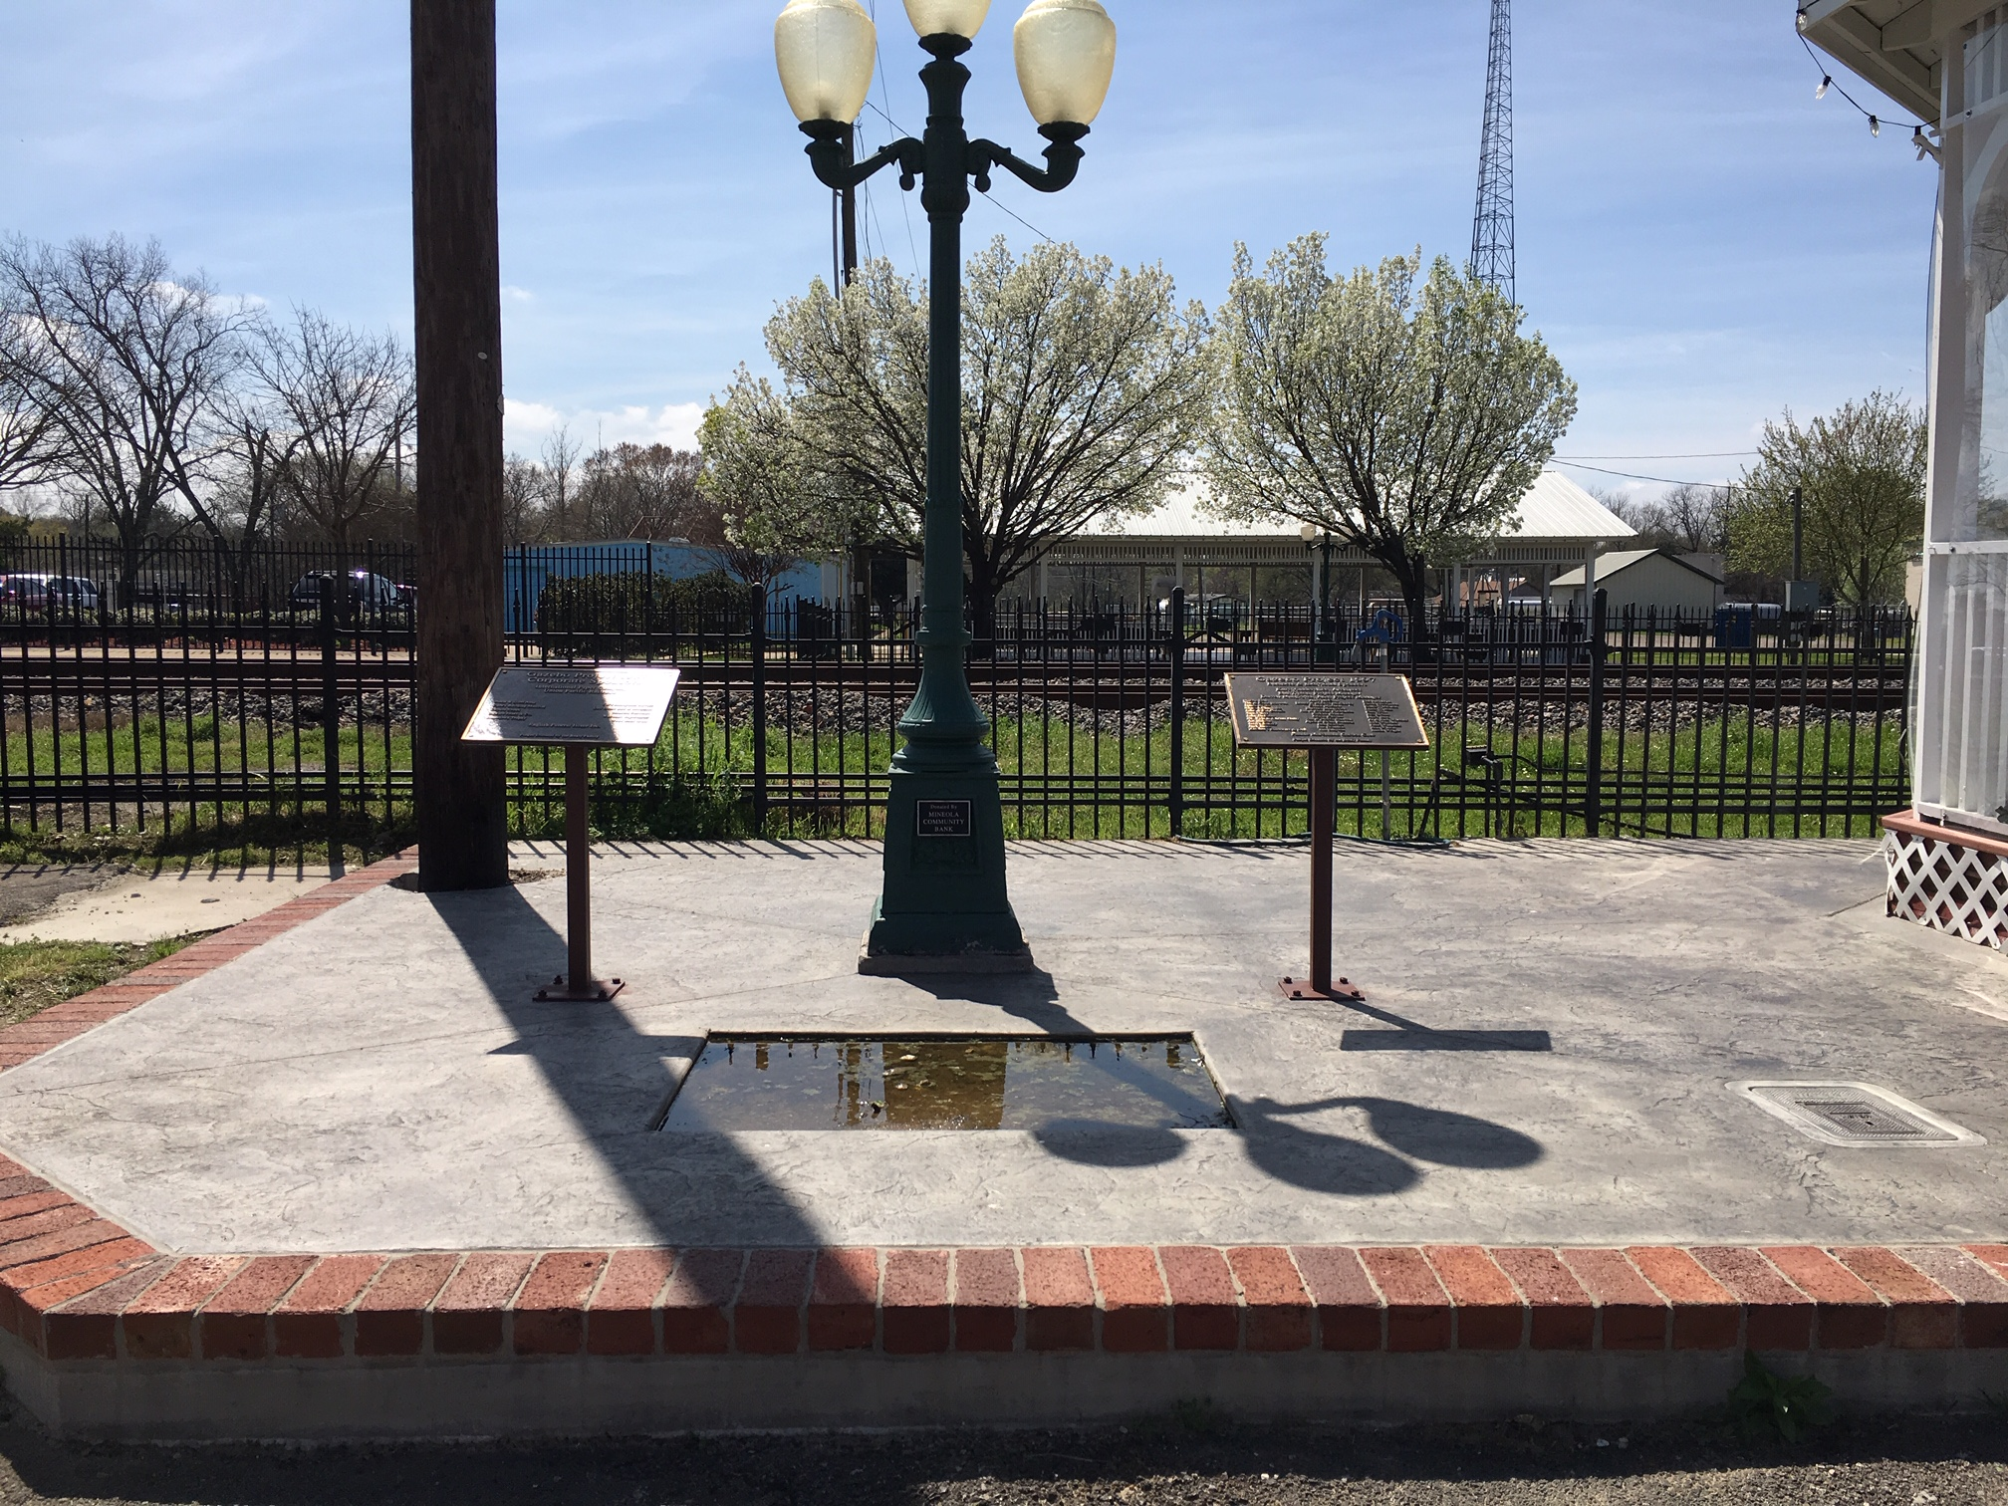
Inset east of Gazebo
BEFORE - Location originally planned for possible memorial bricks, but that option was later decided against. This inset has been unsightly, and receptacle for dirt, trash and water.

Slide 5
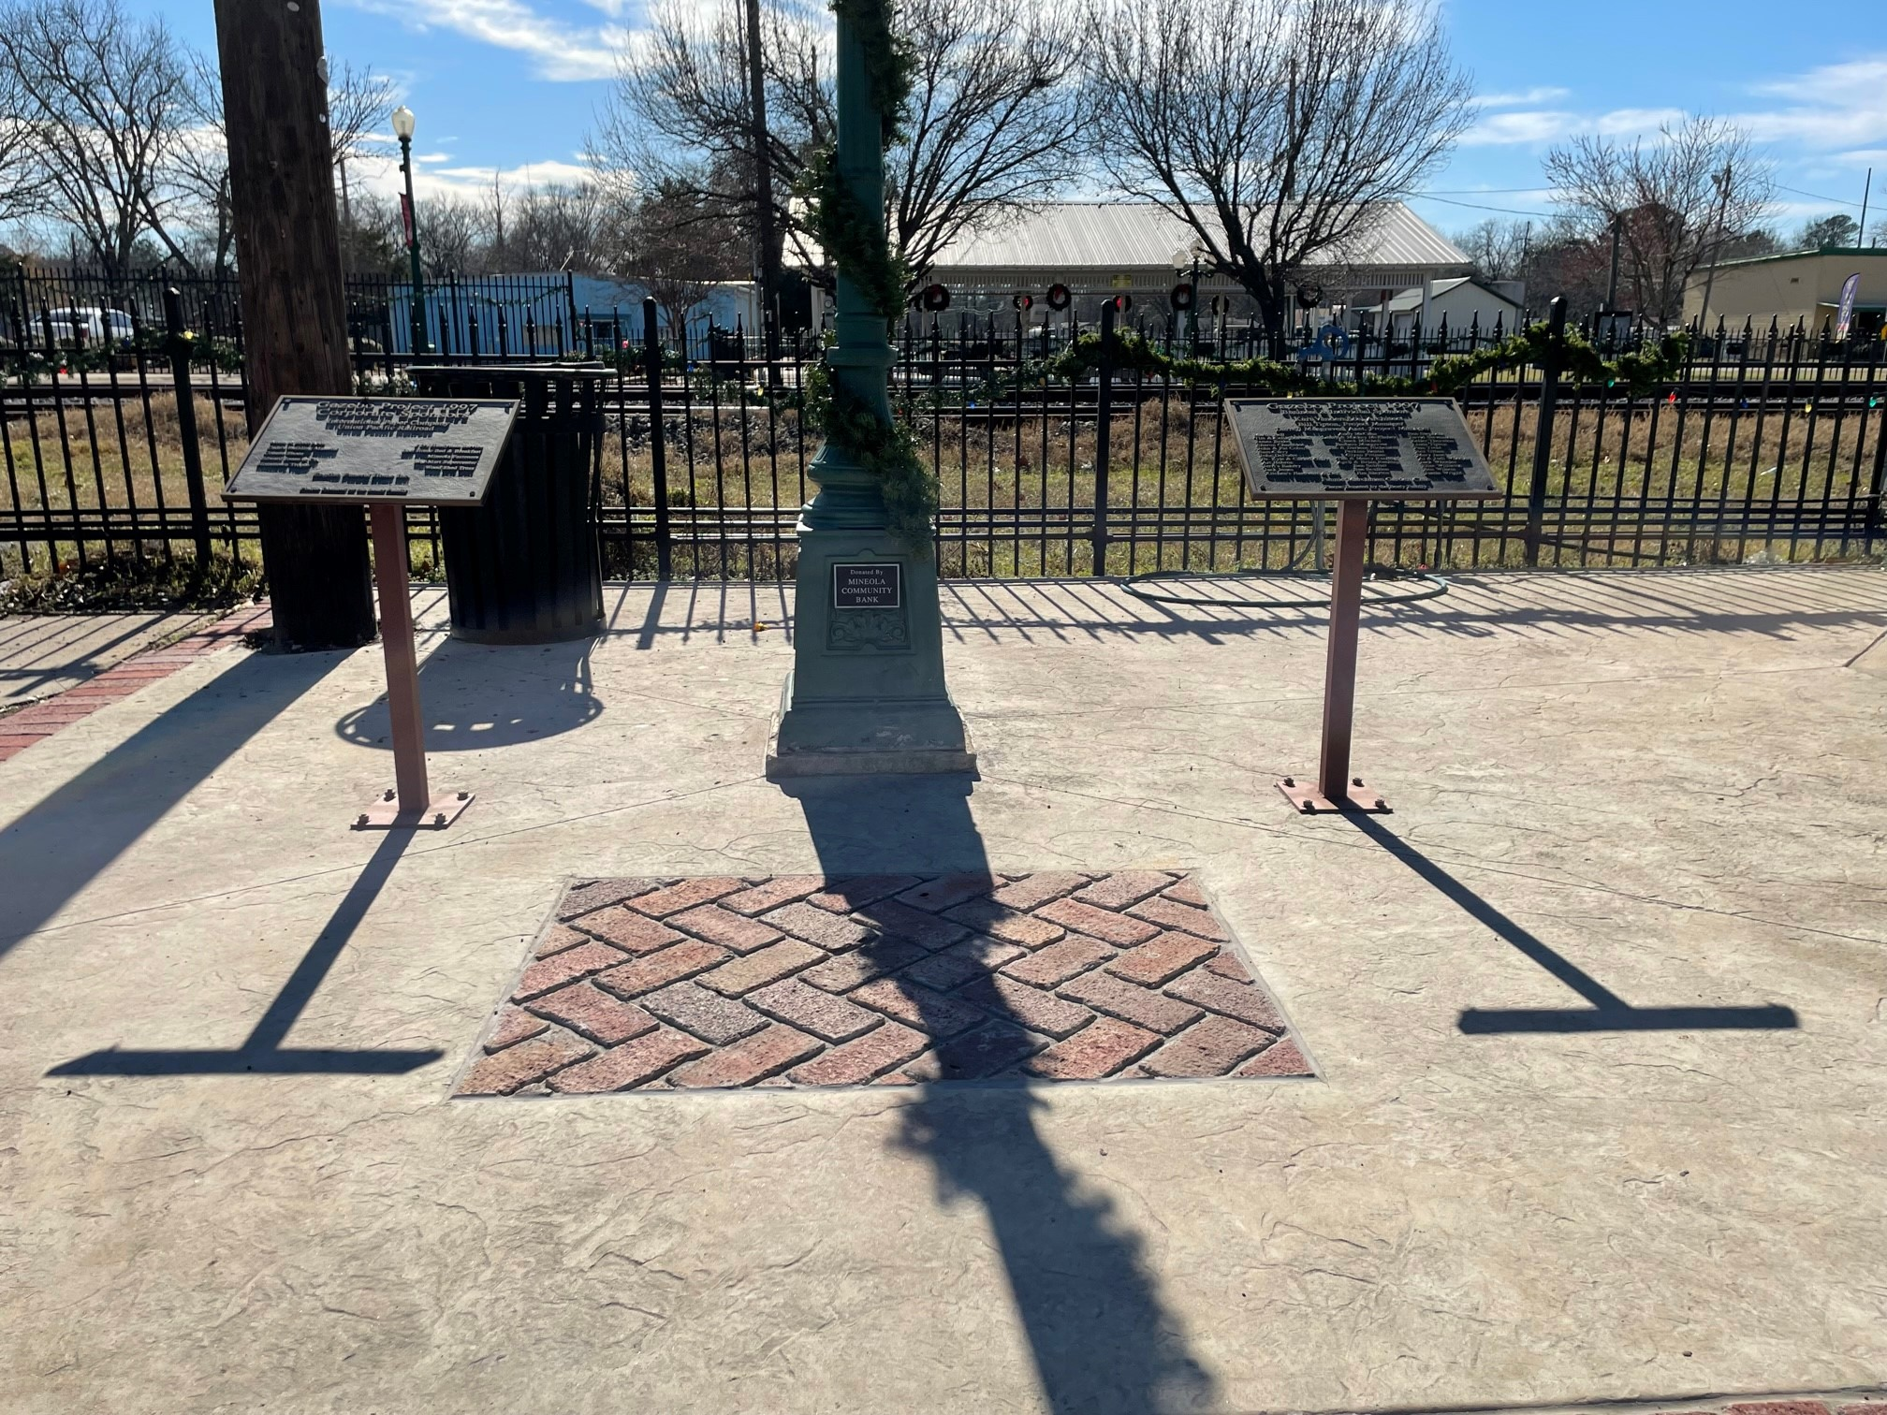
East inset filled
AFTER Main Street Board members chose to fill the inset with bricks set in a herringbone pattern, matching the bricks that edge the apron of concrete constructed around the Gazebo.

Slide 6
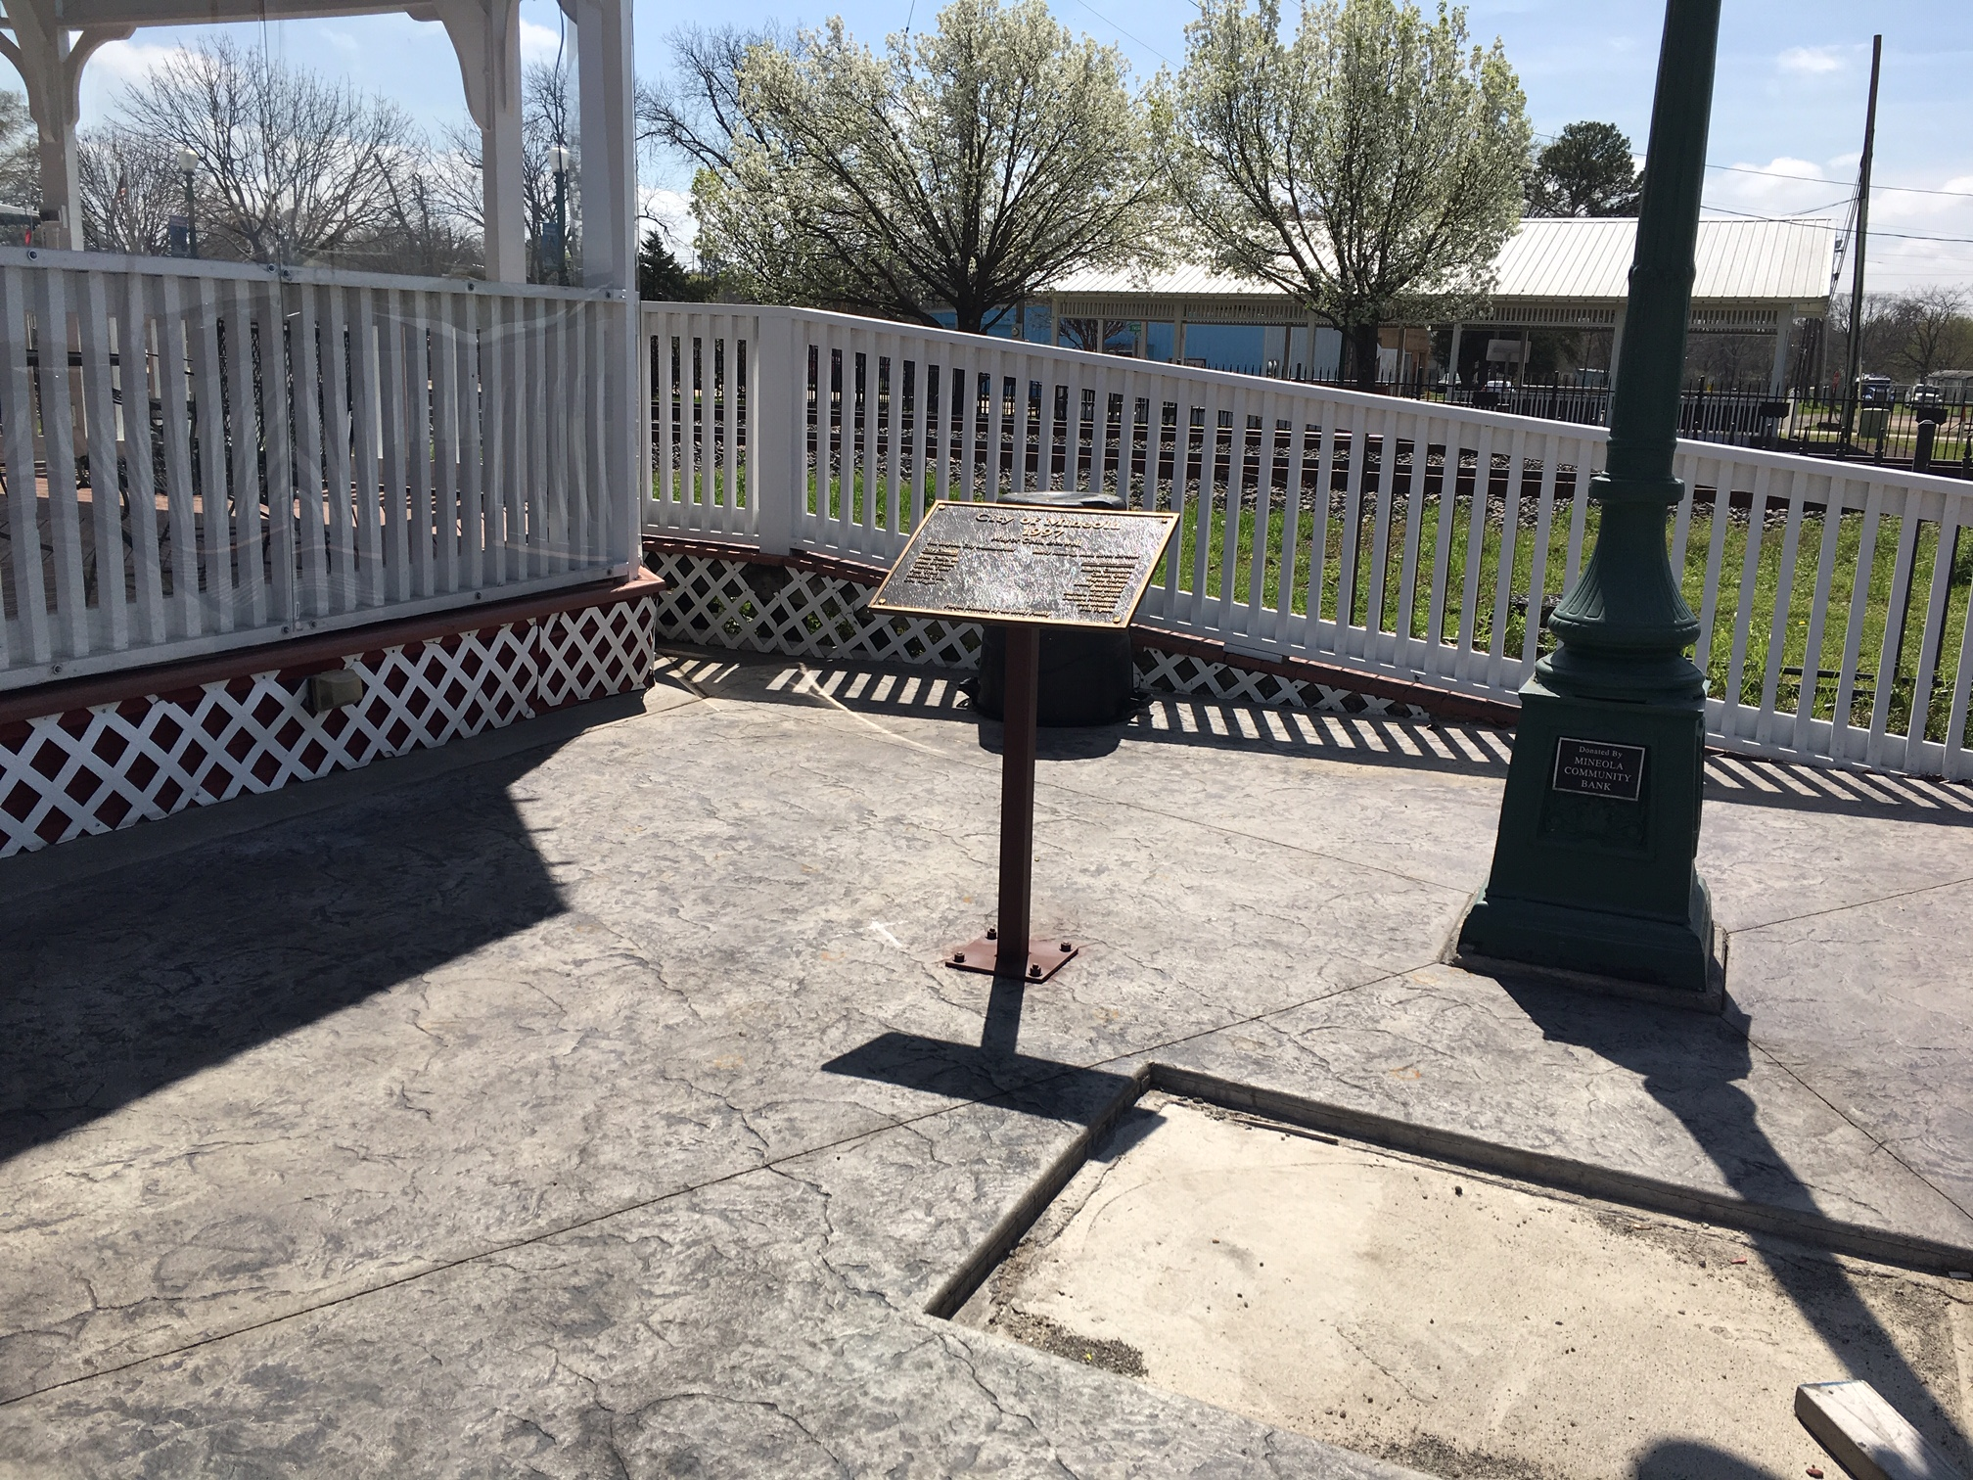
Gazebo west inset
BEFORE

Slide 7
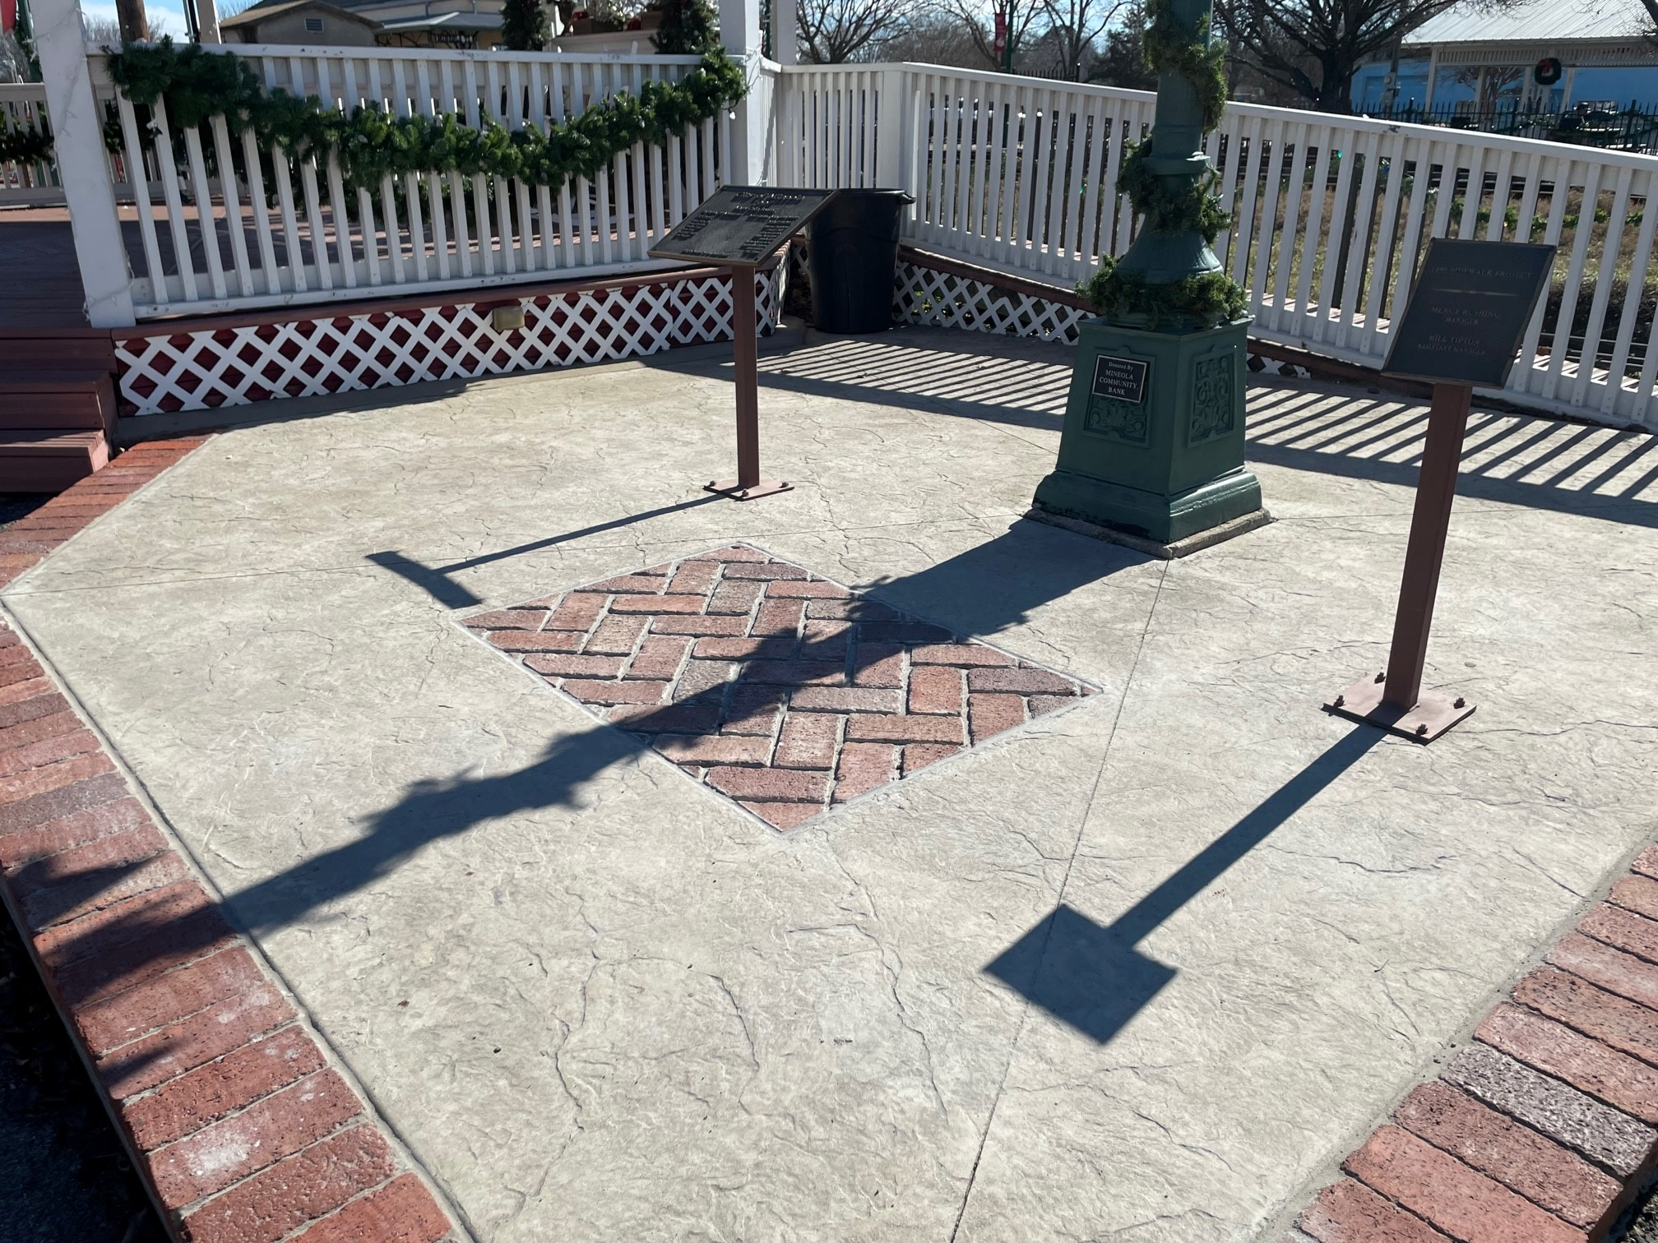
Gazebo west insert
AFTER

Slide 8
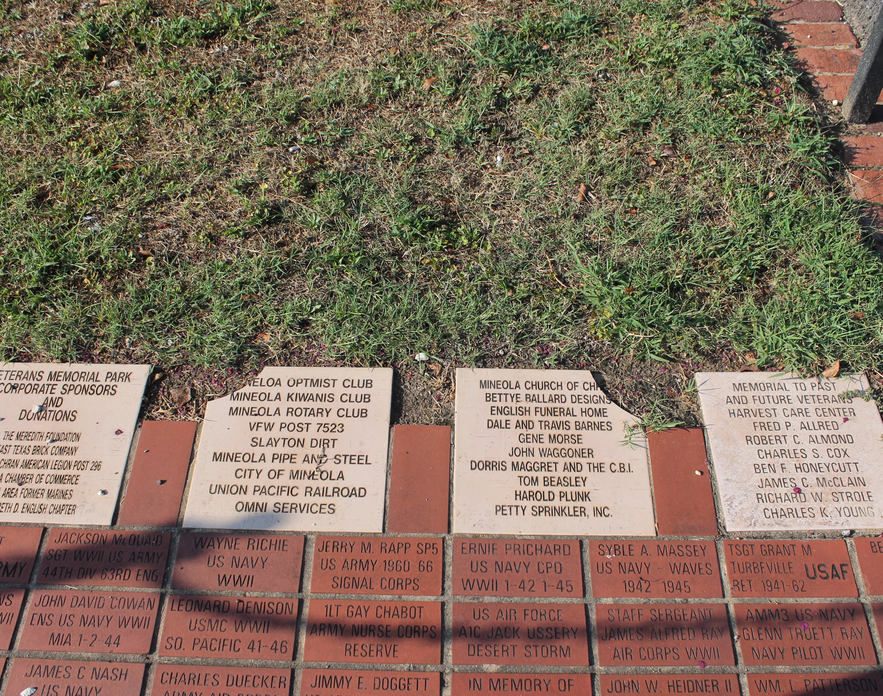
Veterans Memorial
BEFORE Memorial tiles that were damaged were later completely destroyed in a wreck in 2021. They were replaced, were broken a second time, and replaced with thicker paver bricks too deep to lay flush. This project was inherited by the City due to the passing away of many of the original planners.

Slide 9
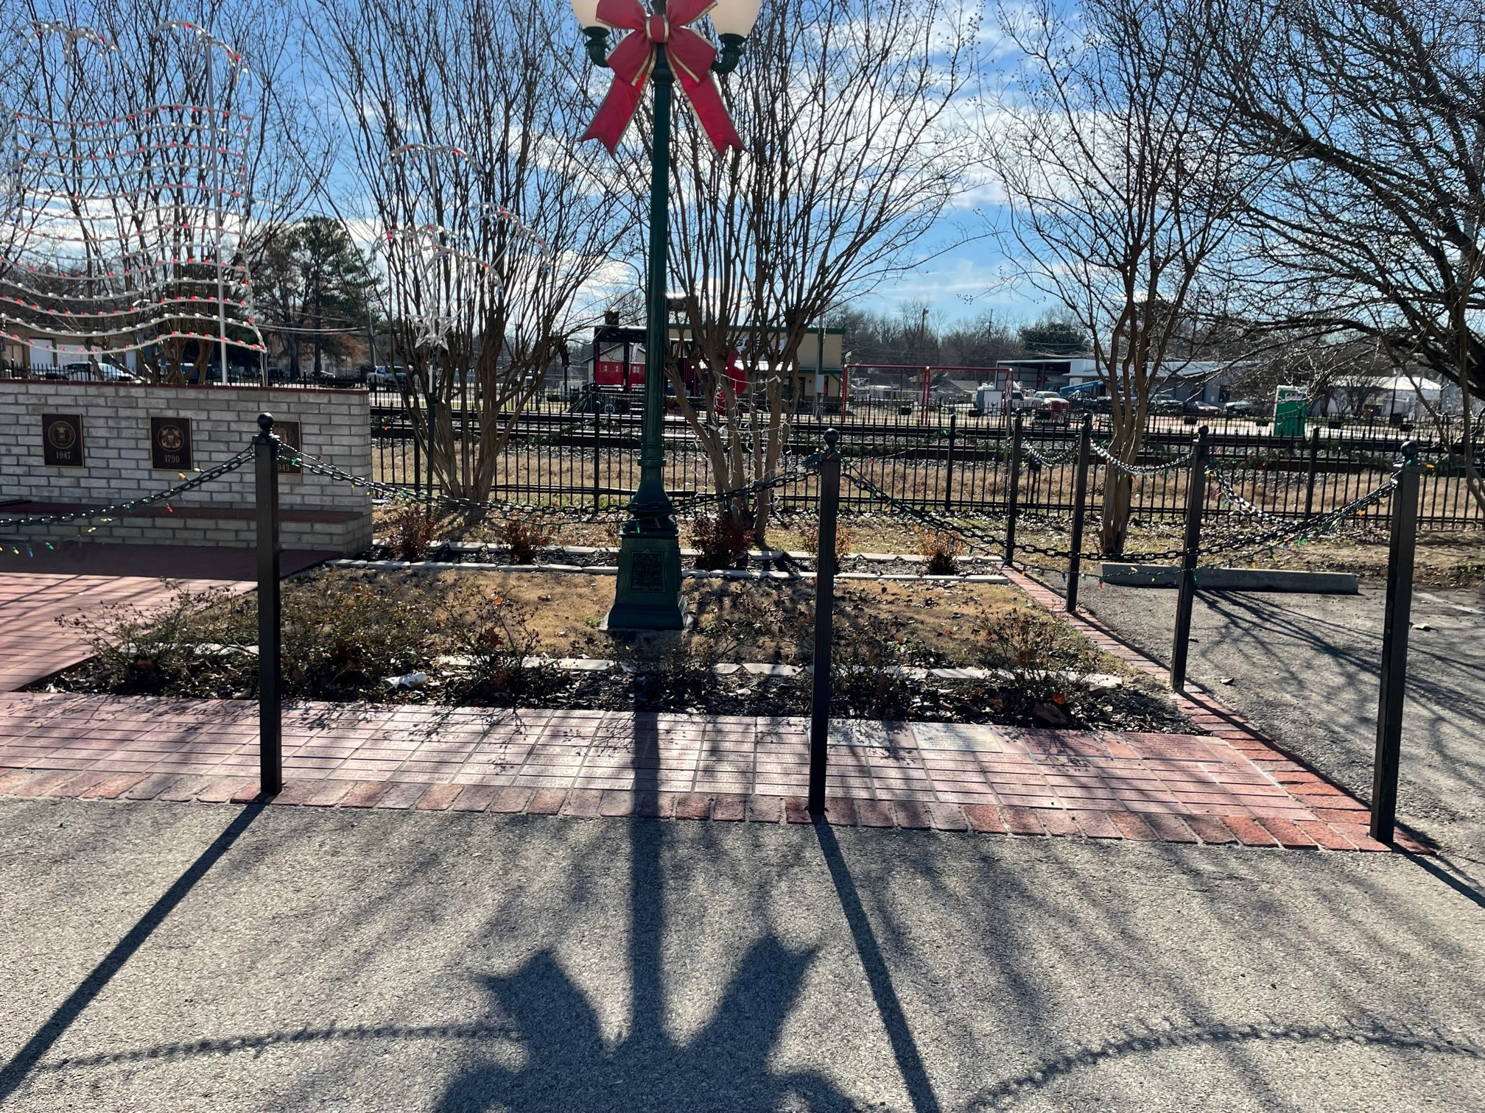
Veterans Memorial
The replacement bricks were laid flush with the existing bricks at the Veterans Memorial. Gaps left between the different shaped bricks were filled and neatened.

